Slide 1
Project Overview
Jason Craughwell

Slide 2
Sport Ireland Initiative – Dormant Accounts Fund
5 largest Cities
Coordinated & facilitated by 8 Local Sports Partnerships
Focused on enabling each city to become and Active City’

Slide 3
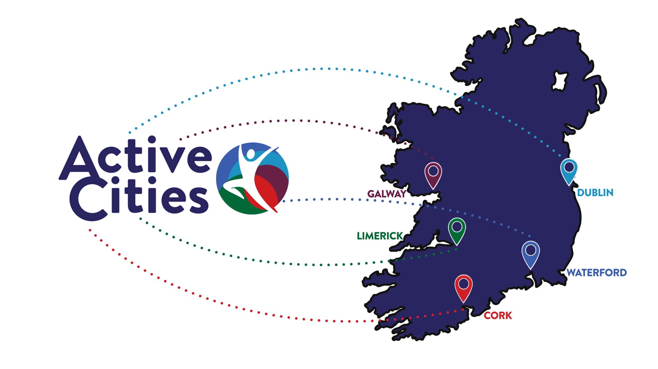

Slide 8
What Is An Active City?
Prioritises physical activity for ALL.
Increases the no. of active spaces throughout the city.
Physical activity becomes a social norm – built into people’s home, work, and community lives.
Seeks to provide equal access and opportunity for ALL to take part.

Slide 10
Active Systems
Implement coordinated actions to increase physical activity and reduce sedentary behaviour.
Raising Awareness – meetings and presentations.
Steering Group – bringing together relevant local agencies.
Baseline Data – establishing city specific data.
Collaboration & Learning – cooperation & best practice.

Slide 11
Active Environments
Create and maintain safe places and spaces to engage in regular sport and physical activity.
Public Spaces – supporting ongoing maximisation of use.
e.g. audit, identify and engage
Cycling & Walking – promotion, support and guidance to decision makers and planners.
e.g. development of Bike Hubs
Innovations – providing new equipment or facility to demonstrate need/impact.
e.g. Bike Bunkers; Pentanque green; inclusive equipment

Slide 12
Active Societies
Enhance knowledge, understanding and appreciation for the multiple benefits of regular activity.
Focus – people who are economically, socially or educationally disadvantaged or who have a disability.
Research – establishing preferred communication channels of target groups.
Communication – neutral branding for an ‘umbrella’ approach to marketing; focus on key messages.
Promotion – building on national initiatives that demonstrate the theme of Active Cities such as: EWOS, Bike Week, Her Outdoors.

Slide 13
Active People
Create access to programmes and opportunities to assist all ages and abilities to participate.
Targeted Initiatives – reaching populations who may not otherwise be engaged. For example:
Discover Fitness for migrant communities
Active Cities guided walks; the FitKidz walking challenge
Innovative Initiatives – ‘Games on the Green’
Community Events – collaborating on events to provide more opportunities.
Building Leadership – supporting clubs to deliver more.

Slide 14
Questions?

